Slide 1

Captsone Two – Video Games Presentation
Presenter: Grace Chang

Slide 2
Problem Statement
1
Context
4
Constraints within solution space
Since all the other regions are having pretty good sales, we want to analyse the Europe region to see if we can make the sales better.
Not understanding different countries' culture, not knowing their taste
2
Criteria for success
5
Stakeholders to provide key insight
Make EU's sales increase 5%
Advertisement team, PR team
Sales team
3
Scope of solution space
6
Key data sources
Find out what EU's preference for game and use different ways such as promotion or advertisement to increase the sales
Sales Data, PR resources
Notes:
Hypothesis: Create a Hypothesis with an emphasis on SMART principles. (S – Specific, M – Measurable, A – Achievable, R – Realistic, T – Timebound). If you cannot do this, you do not have a good grasp on the business problem.
Context: With context, we have clearly identified the problem at hand and have elucidated on how our initiative may solve this problem, alongside the commercial implications this will have on the business.
Criteria for Success: Clearly defining the criteria for success ensures that the scope of your work is clearly defined and understood. Otherwise, if this isn’t defined – your work will never end which will result in mismatched expectations.
Scope of Solution Space: Scoping out the solution space ensures that the business initiative is SPECIFIC for a certain segment or area. This prevents solutions that have been developed being scaled and applied for all other business units that the solution may not be responsible or scalable for.
Constraints within Solution Space: Looking forward, what are the foreseeable problems we are likely to encounter? Could this be stakeholder resistance? Could this be we don’t have access to the right data?
Stakeholders to provide key insight: Who are the people I need to speak to, to get the answers I need for my data analysis?
What key data sources are required?
Based off my discussions with the key stakeholders – can we clearly list out all the data sources we need so we can make a highly targeted request as opposed to a scatter-gun approach where we ask for a bit of everything?

Slide 3
Issue Tree
Have retain customer to purchase more
promotion, discount, loyalty points
Advertisement of the product they might not know
Increase EU's sales 5% in one year
Cold calling/emailing etc
Develop strategies to attract new customer
Trial version to let them try
New region
Explore new market
Different age (eldery)

Slide 4
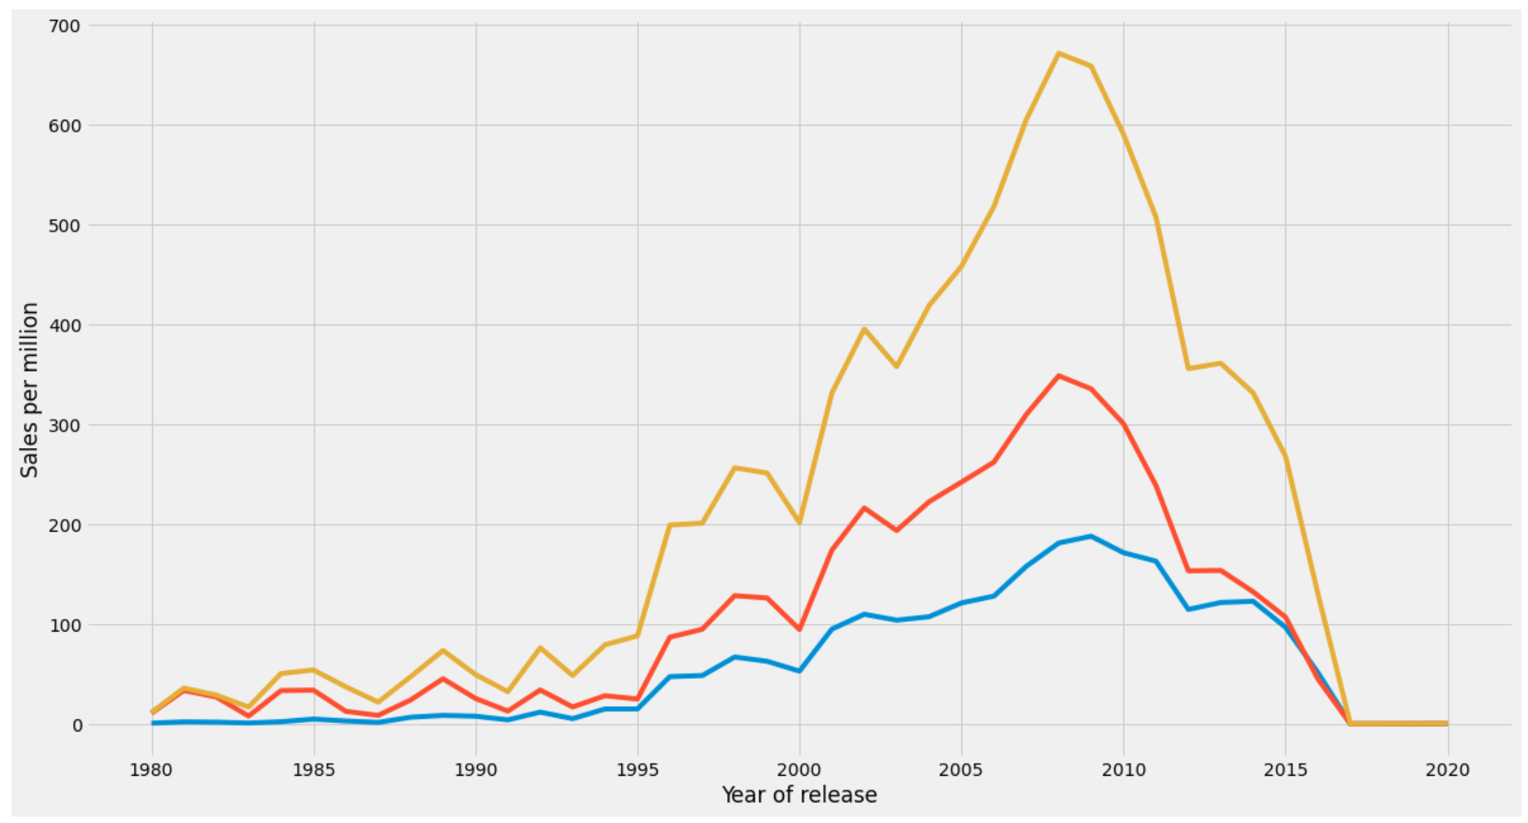
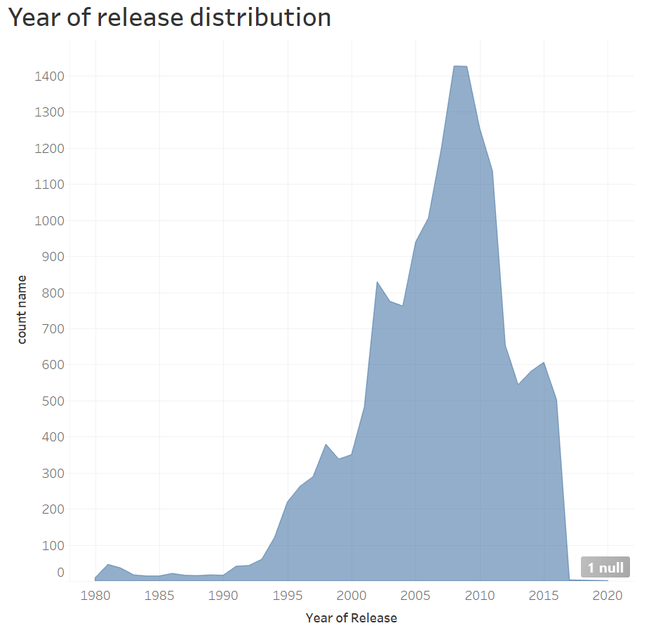
Overview Huge increase since the 1995 - every spikes are the time when games are having new released. The decline - there might because of the financial crisis, or with lack of new games to keep customer interested. But for the Europe’s sales, we can see it has always been at the button, so there must be a lot of improvement to make it better.
Global Sales
JP Sales
EU Sales

Slide 5
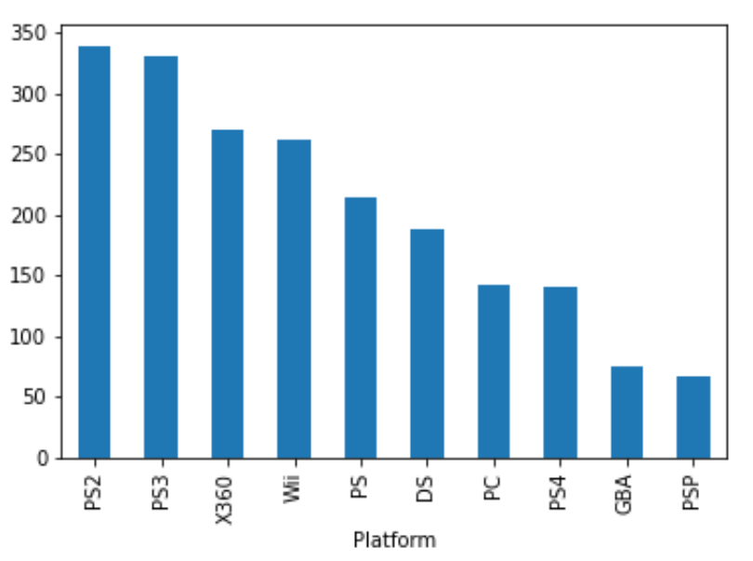
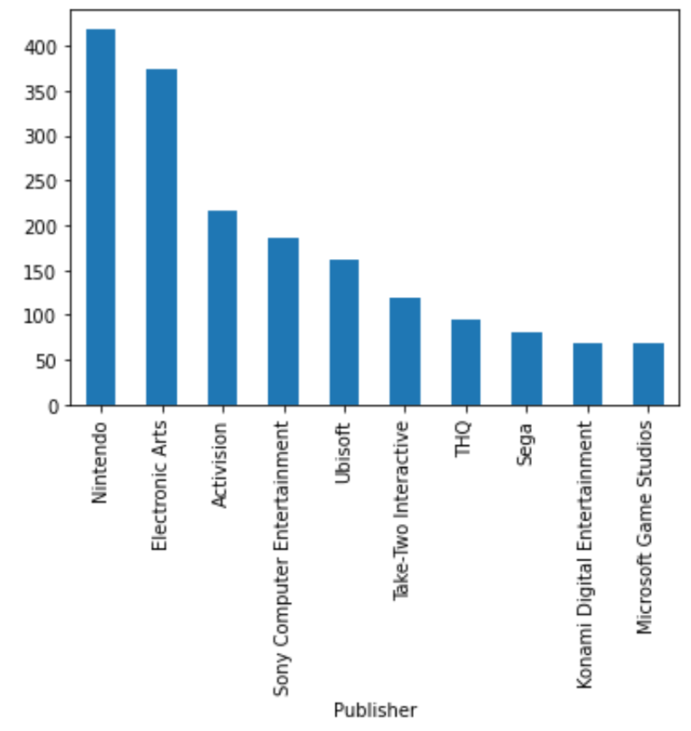
most popular video game consoles and Publisher in EU’s sales By platform - Promote PS2 more or try to advertise second/ third console By Publisher - Promote Activision as there is a big gap , there will be lot of sales can improve

Slide 6
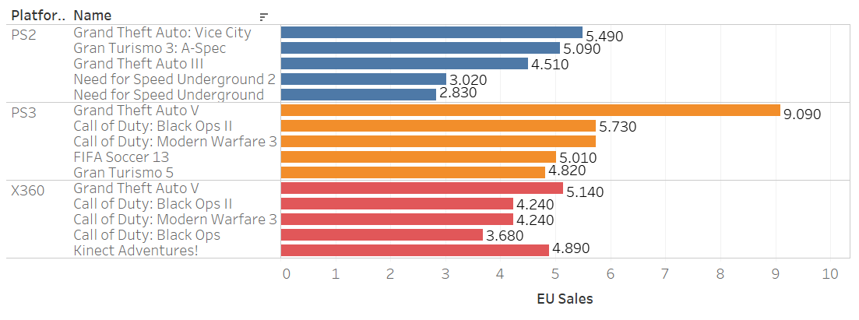
Best selling games in each platform Three video games are dominating the sales on these platform, and PS3 are completely dominated by Grand Theft Auto

Slide 7
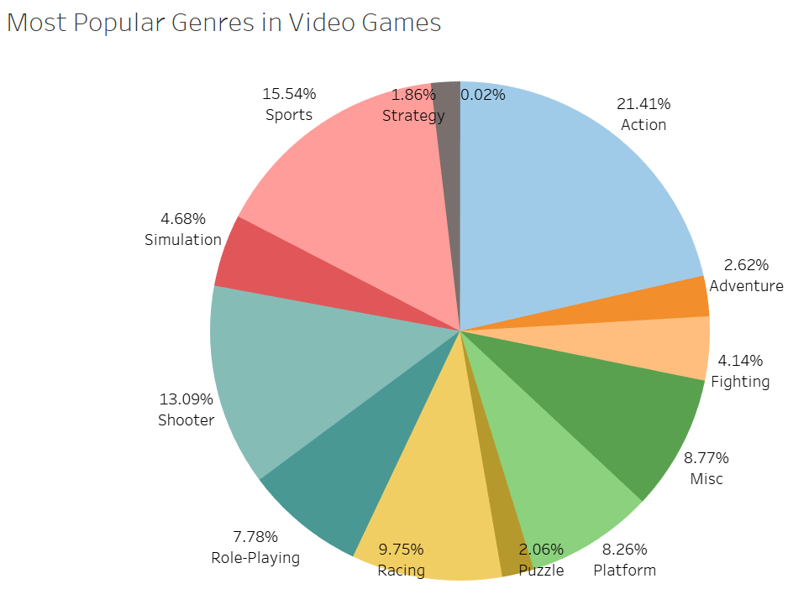
This pie chart shows that Action genres are the most popular one, base on previous slides, the popular games are all actions category too, so we can know that the Action, Sports and Shooter are the popular Genre.

Slide 8
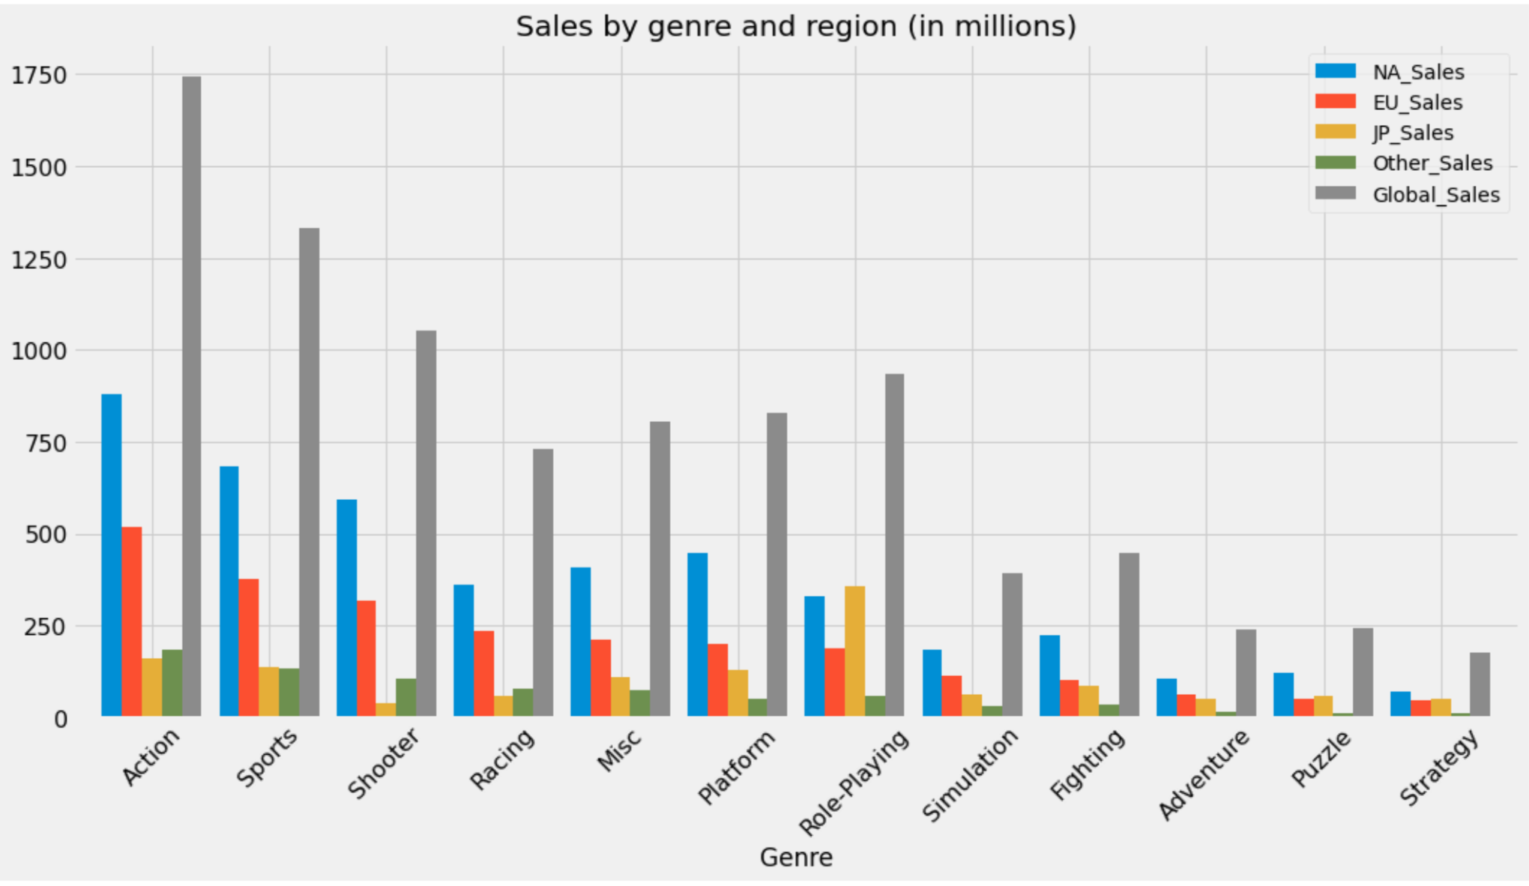
Genre by regions EU’s popular Genre are Action, Sports and Shooter.

Slide 9
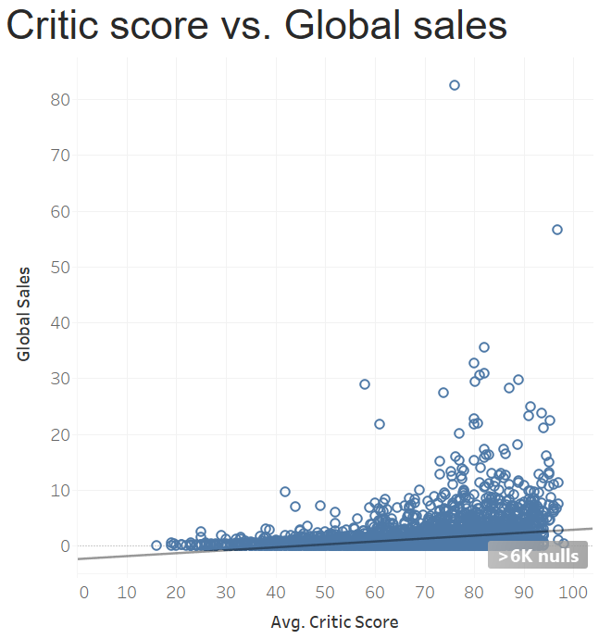
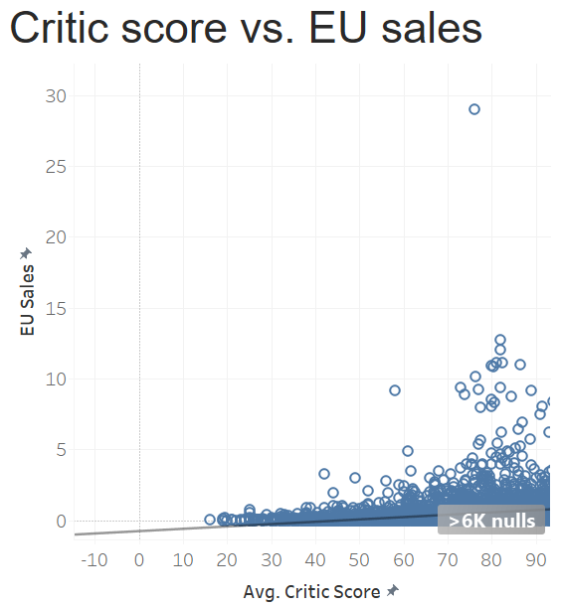
The higher critic score the game have, the more sales it make.

Slide 10
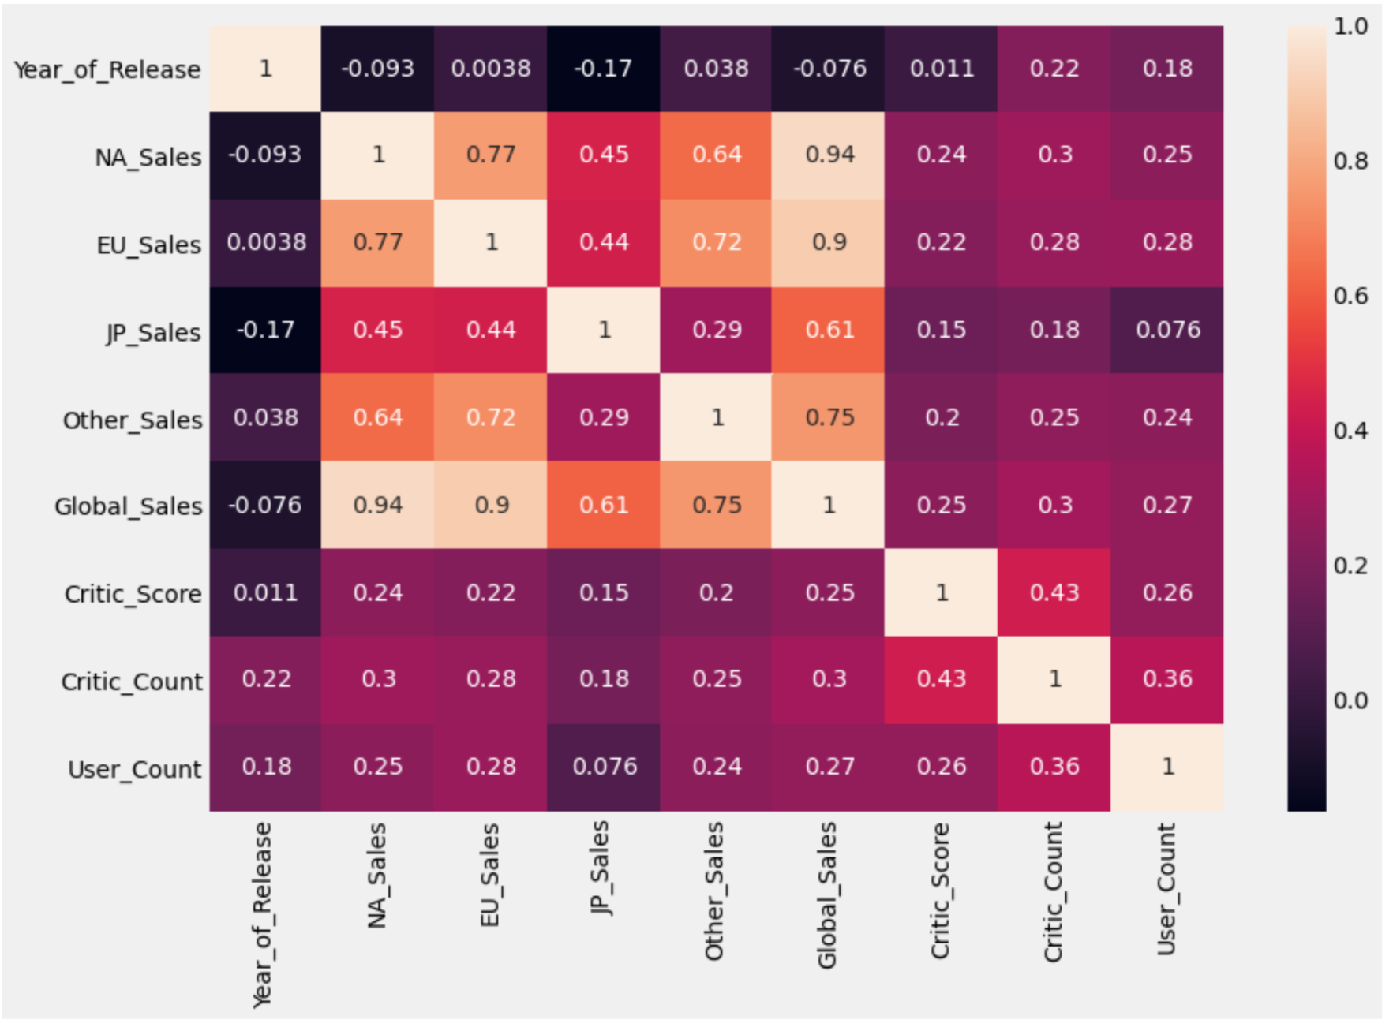
Correlation Heatmap EU sales is pretty highly related to Other_sales region, so we should copy how Other sales region’s way of promotion and advertisement etc, Increase EU sales, increase NA sales

Slide 11
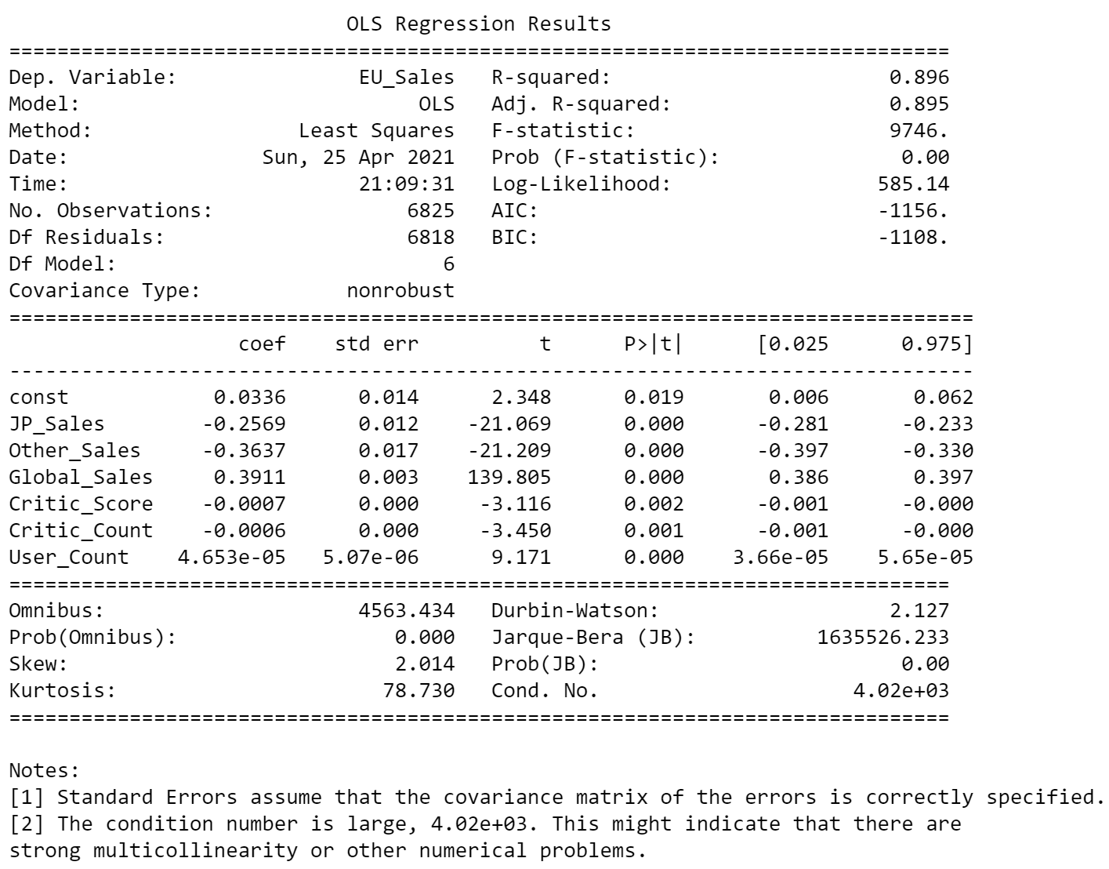
Regression Analysis
As already filtered the P value to < 0.05, those are highly related to EU sales:
JP_Sales, Other_Sales, Ceitic_Score and Critic_Count are having negative relationship, meaning that if EU sales goes up, those are going down

Slide 12

Conclusion
Although the data is only up to 2016, there are quite few years data missing till now, we can still try to look for similar economic environment and learn from that timing.
For EU sales, there are definitely a lot of space can be improved, base on all the analysis I created, I believe we already have some direction to go and focus to increase EU’s sales.

